Slide 1
Weather Forecast Project
Jingwei Huang, Hanshun Li, Hanyun Cui

Slide 2
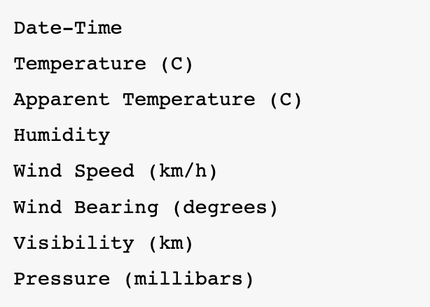
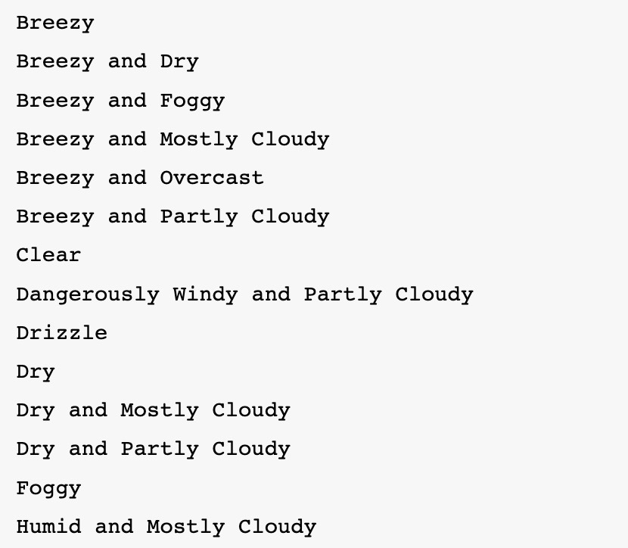
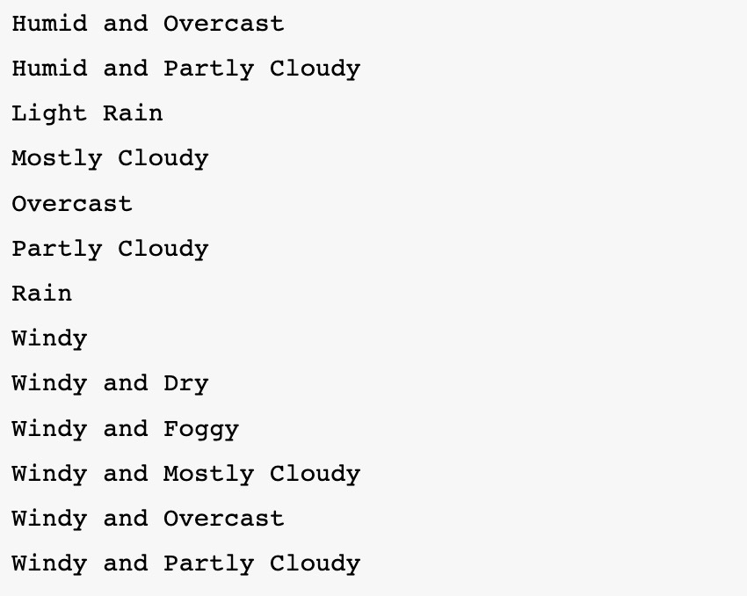
Purpose of model
Weather data analysis:
Classify all the weather cases to 27 categories
- Predicting the weather with 8 parameters: (input)
27 classes of weather (output):
Partial reason of low accuracy( the frequency with which the prediction matches labels)

Slide 3
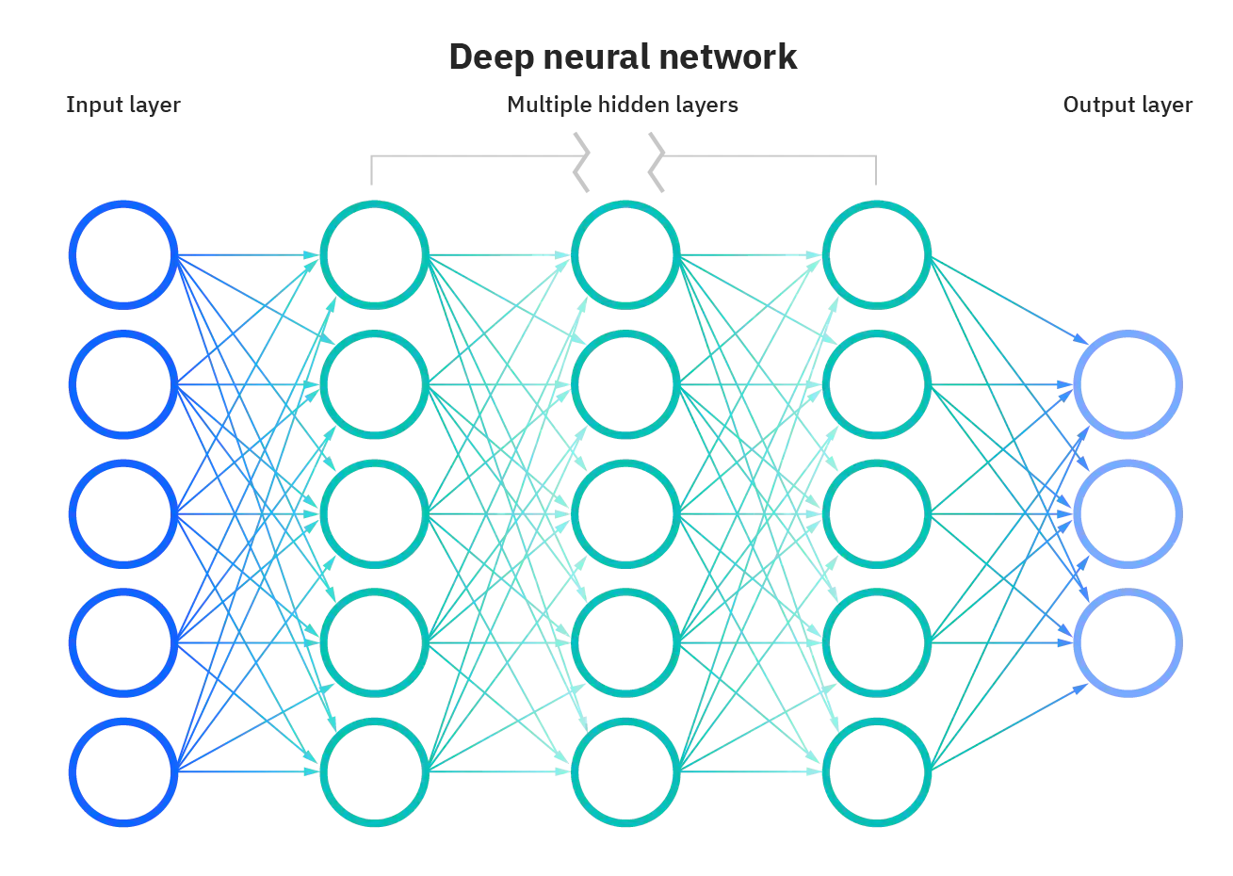
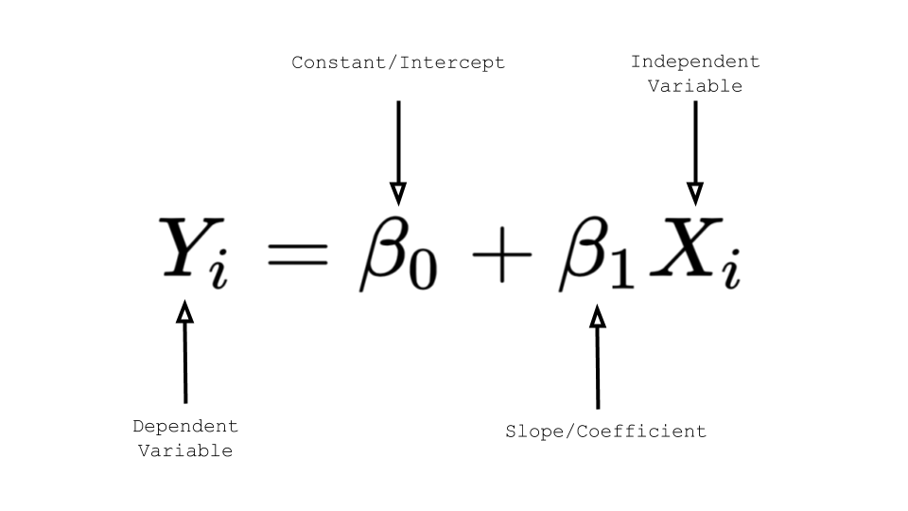
Model construction
We adopt 3 models to fit the data and 2 of them are from previous courses
Linear regression model (single layer)
Deep neural network model (multilayer)

Slide 4
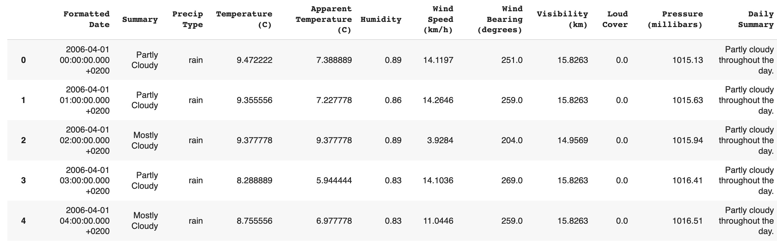
Our dataset
The dataset is from Kaggle which link is
https://www.kaggle.com/datasets/muthuj7/weather-dataset
OUTPUT
INPUT

Slide 5
Model Roadmap
Data processing
Building model
Evaluation
Result
The MSE and accuracy of each individual models were calculated and graphed, then the results were compared to each other, this is where we found that the most “accurate” model to be the random forest model from other developers.
First listed data set using function in pandas package, then rows and columns were selected for independent variables and dependent variables to form X and Y used for training
The baseline model used was the linear regression model. Second, we tried using an ANN multilayer model, set with different values for layers and epochs. The final model used was a copy of model online.(for comparison)
We came up with an conclusion towards our models, finding that the multilayer ANN produced a lower MSE value and a higher accuracy value. This means the ANN model is better suited in this situation (expect random forest).

Slide 6
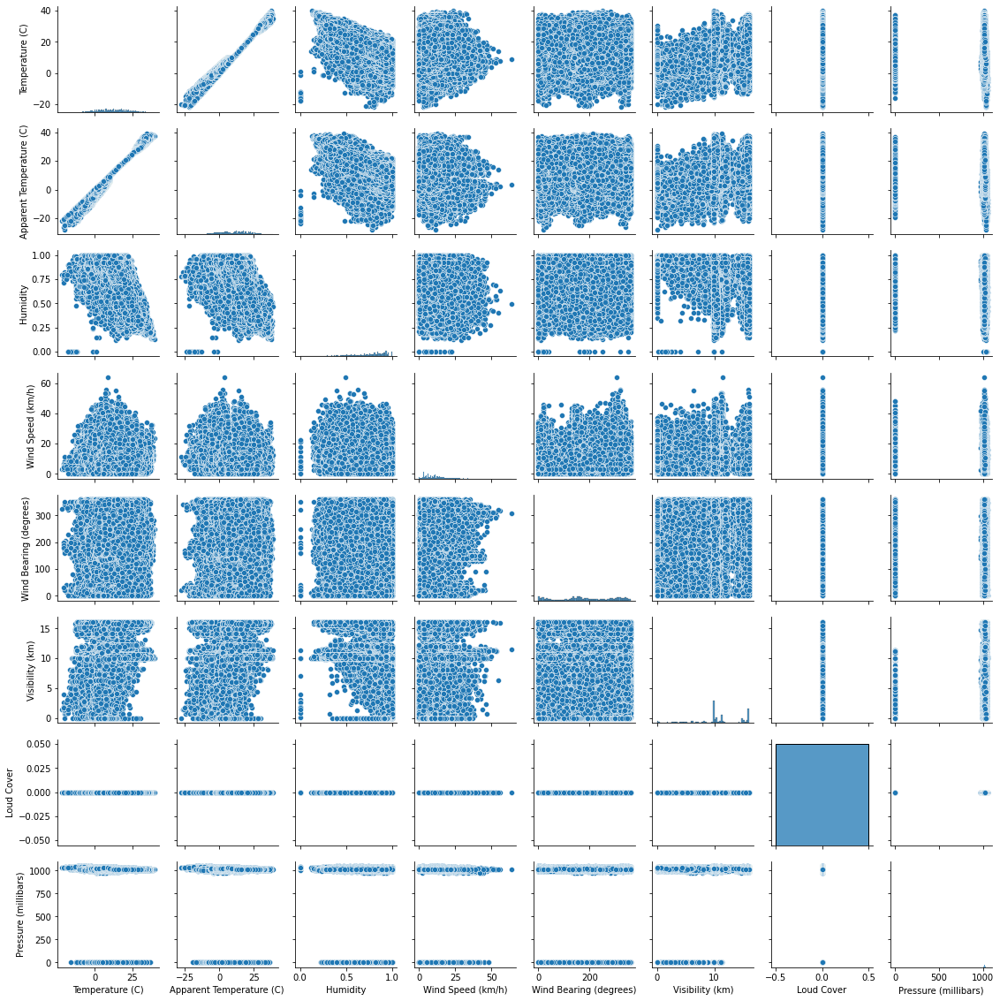
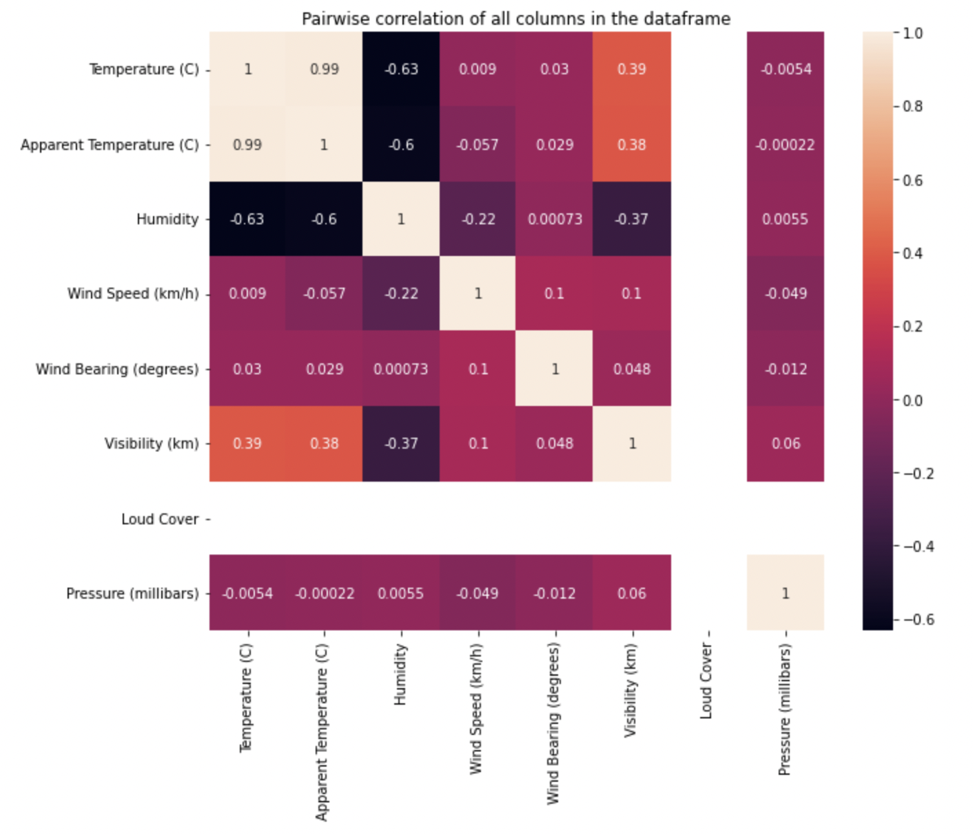
Correlational study (finding relevant variables)
Data processing
Finding variables that had high correlation, meaning we need to remove one of temperature or apparent temperature to modify our dataset because these two variables are essentially the same thing. Plus, loud cover is removed since it stays the same in the whole dataset.
Pairplot
Heatmap

Slide 7
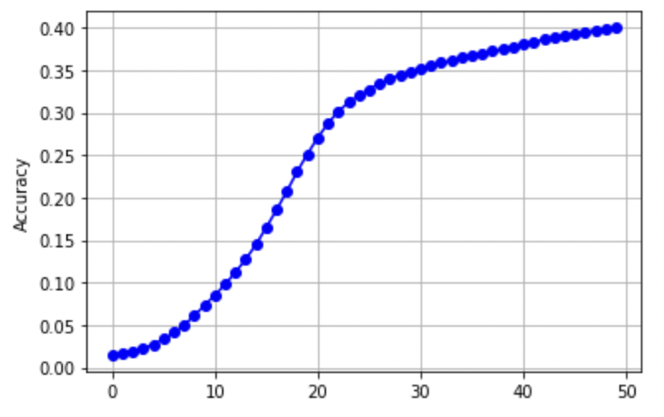
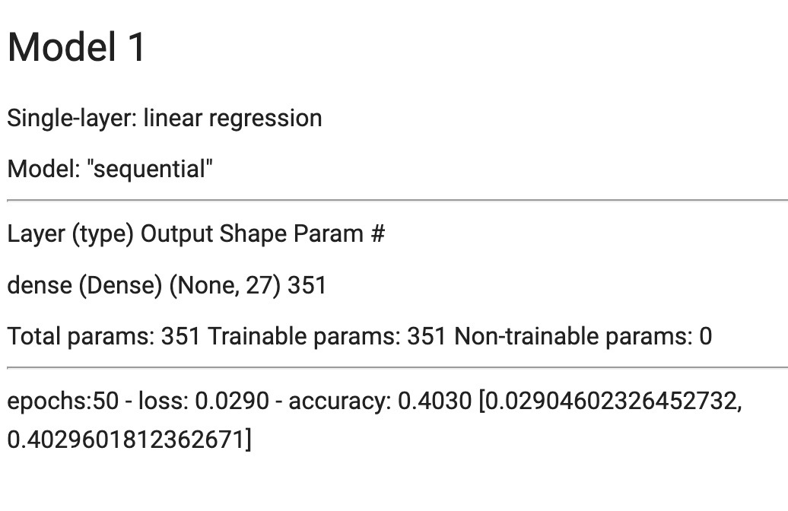
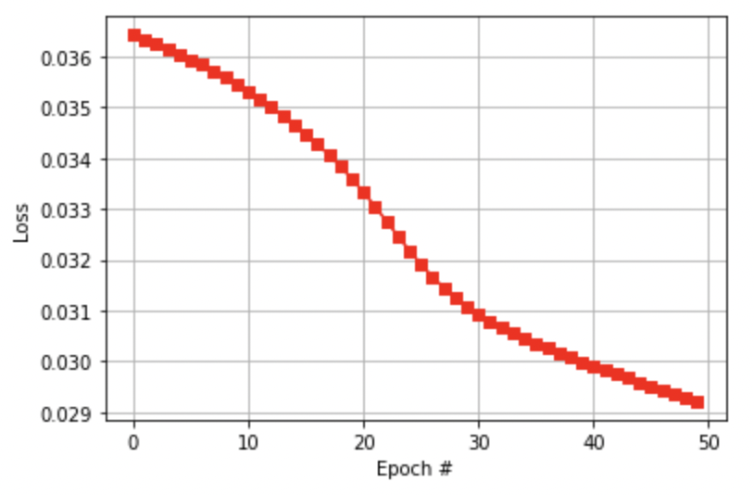
Modeling: Data visualization
Model 1:
Linear
regression
The accuracy tend to reach a limit at about 0.42

Slide 8
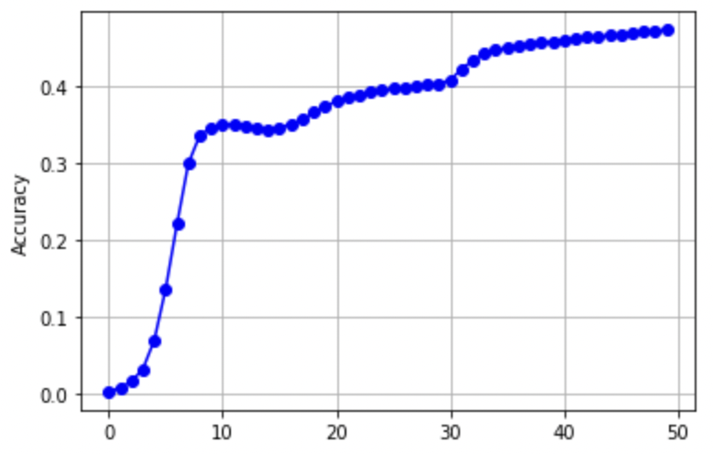
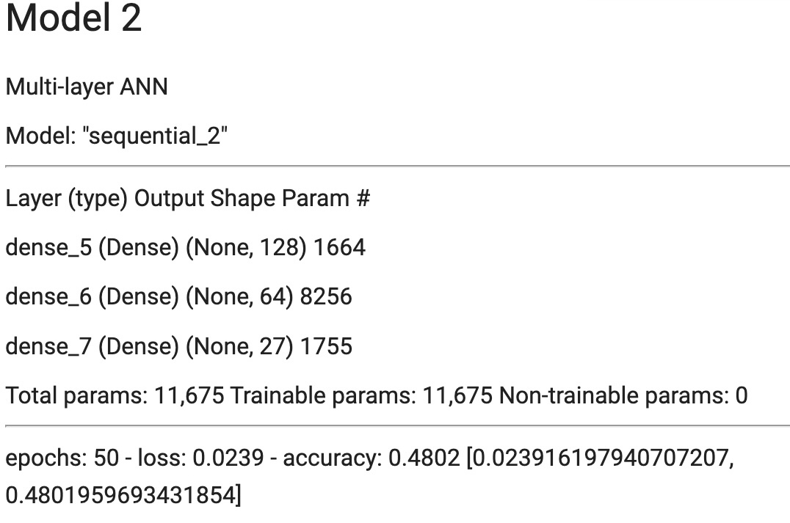
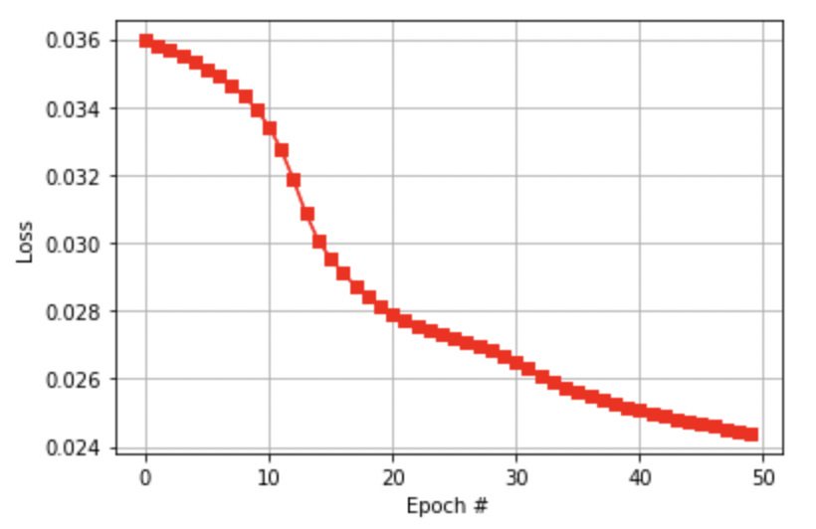
Modeling: Data visualization
Model 2: Multilayer ANN
The accuracy tend to reach a limit at about 0.50

Slide 9
Comparison & Conclusion
Comparison of models:
Conclusion:
Our best model produced in this project is ANN multilayer neural network (except random forest), but because there are too many ambiguous classes for output, our accuracy remained lower than expected.
From this project we learned that linear regression is not always accurate and does represent most cases of real life application. We need to choose the appropriate models for certain datasets.
Plus, we chose too much classes (27 classes) and they are somewhat too ambiguous for a simple model to fit (even random forest model only reached 0.684). Thus, we should think more carefully about which data to use as output.
Models | MSE (loss) | Accuracy
Linear regression (Single layer) | 0.0290 | 0.4030
Multilayer ANN (Multilayer) | 0.0239 | 0.4802
Imported model (Random Forest) | ? | 0.684

Slide 10
THANKS FOR
WATCHING

